Slide 1
Monitoring vegetation restoration at McKinley Mine, New Mexico
Christian Haselwimmer
Project Mentors: Nayani Ilangakoon (CU EarthLab), Steve Perkins (Chevron)

Slide 2
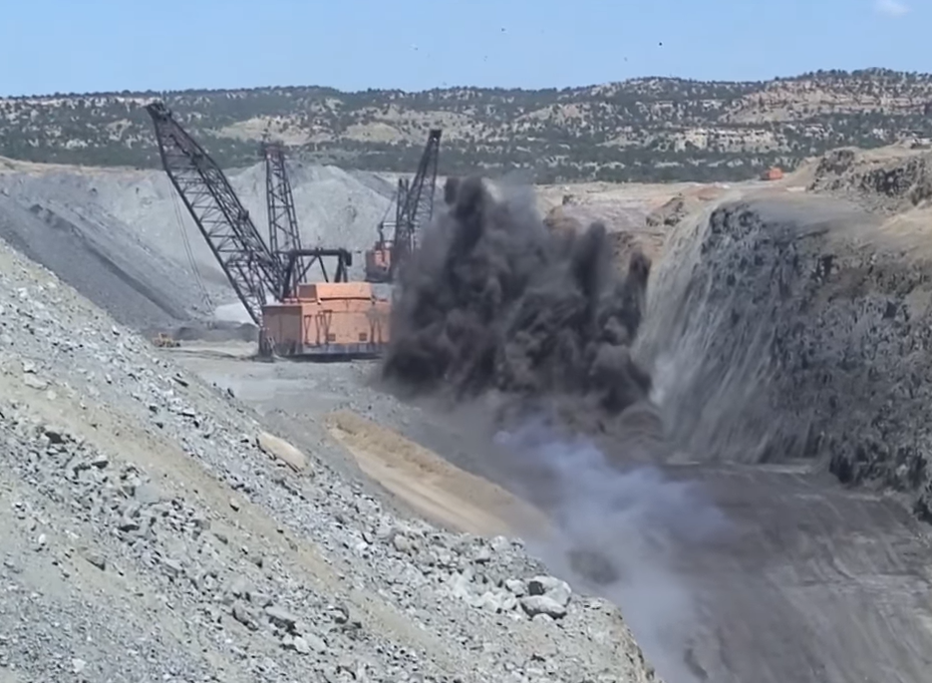
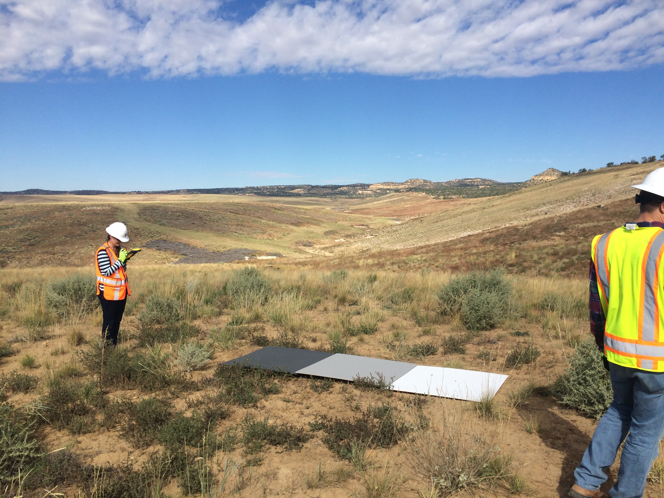
Asset closure and ecological restoration
Notes:
Ecological impacts of resource extraction projects
Critical to restore ecosystems after projects close
Ongoing + future resource demands

Slide 3
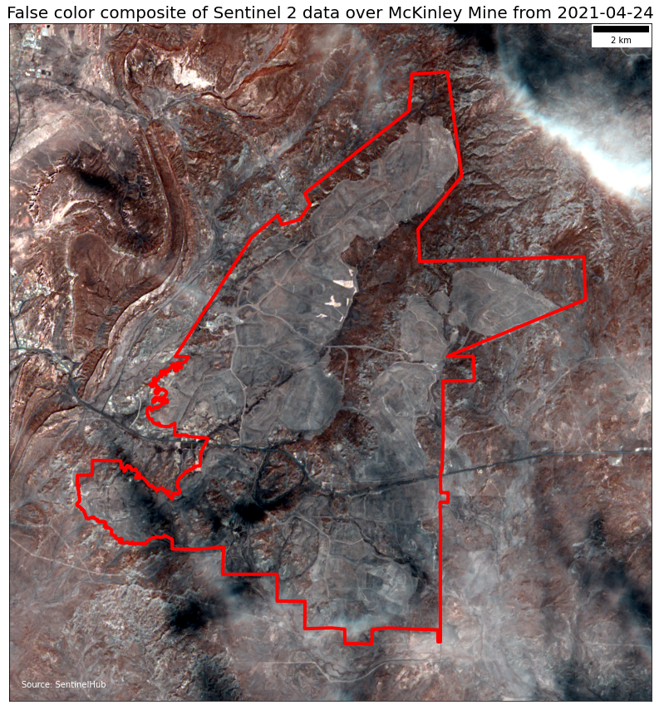
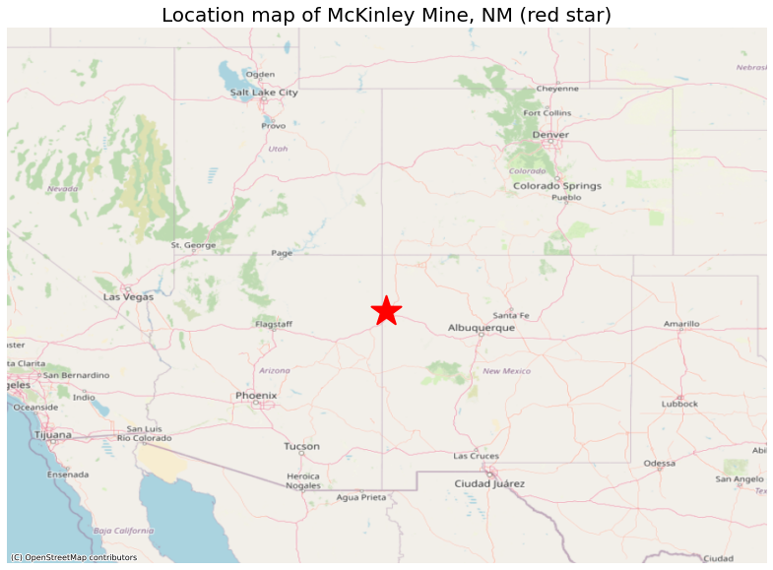
McKinley Mine, NM
Notes:
27,000-acre former open-pit coal mine
Closed in 2009 & site reclamation completed
Different areas at different stages of vegetation restoration
Requirements to monitor success and sustainability of vegetation restoration measures

Slide 4
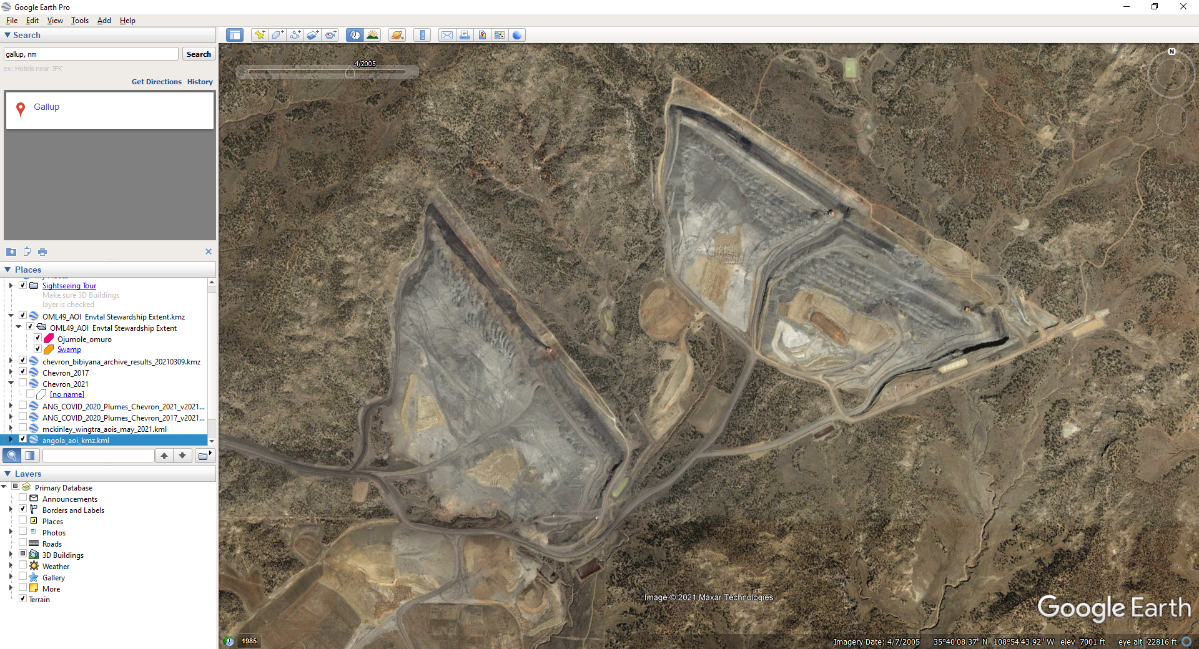
2005

Slide 5
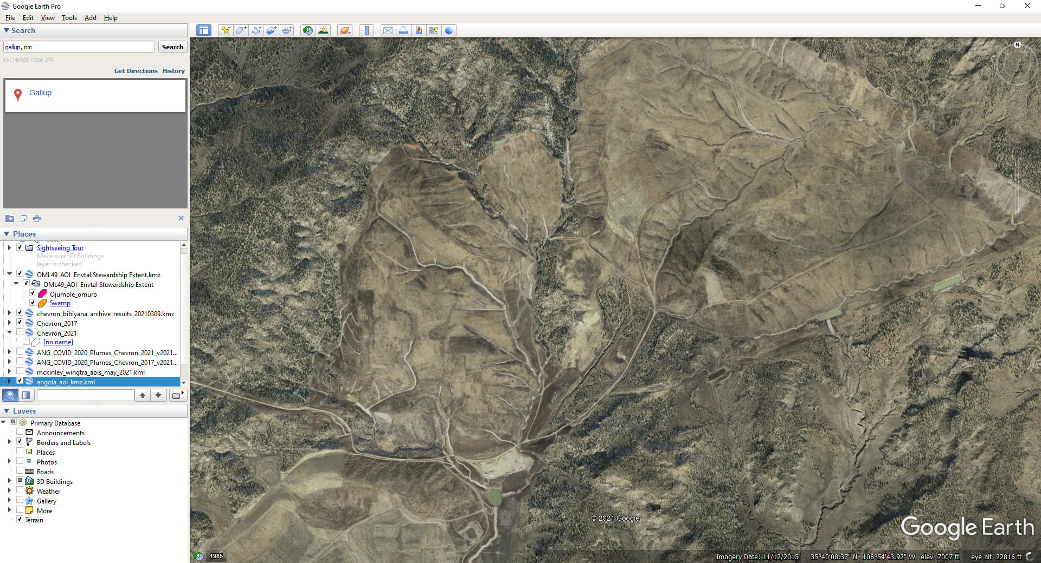
2021
Vegetation re-seeding and monitoring

Slide 6
Project overview
Science questions:
What is the trajectory of vegetation restoration measures?
How is weather/climate impacting these measures?
Methods:
Build time series of remote sensing vegetation indices
Extract time series of weather/climate data
Build statistical models to understand controlling variables

Slide 7
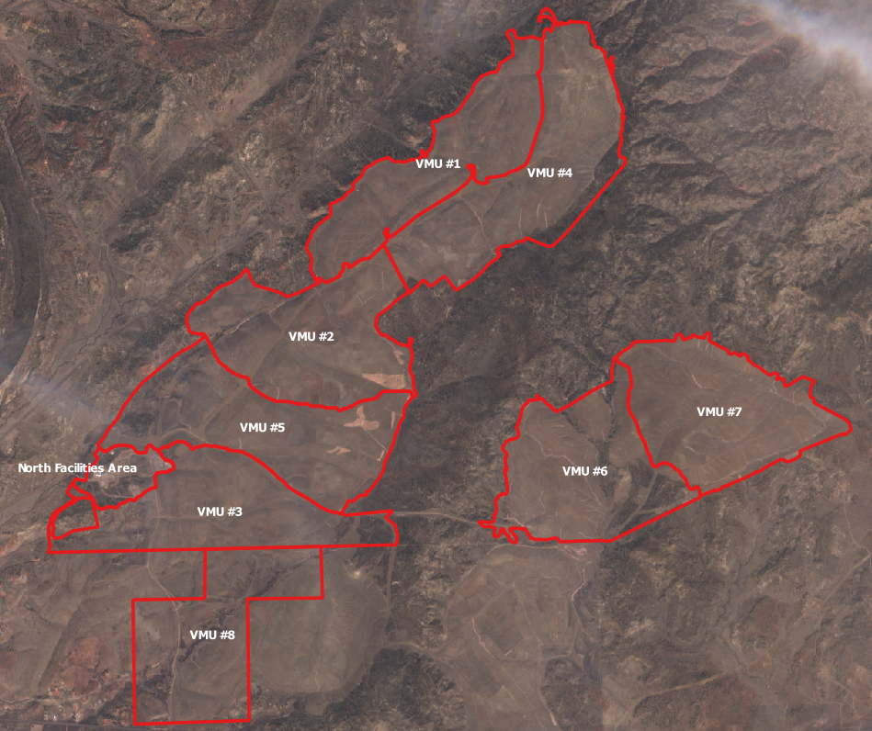
Remote sensing data analysis
Sentinel 2 and Landsat 8 data, 2013-current
SentinelHub “Statistical Info Service” API
NDVI, SAVI time series
Average over management or seeding “units”

Slide 8
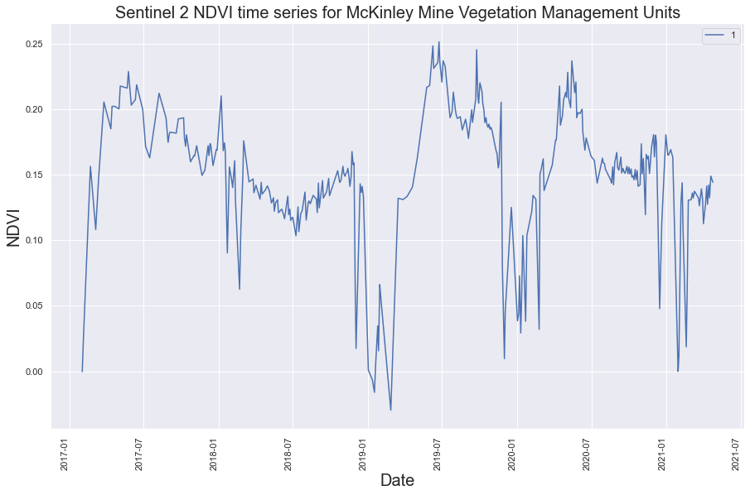

Slide 9
Next steps: weather data + modeling
Data from:
aWhere Daily Observed Weather
GRIDMET: accessed through Google Earth Engine
Field rain gauges
Metrics: annual min/max temp, precipitation etc…
Remote sensing metrics: max NDVI, NDVI slope etc…
Scikit-Learn: regression, cross-correlation models

